Slide 1
Context Free Grammers (CFG), Parse Trees, and Push Down Automata (PDA) Models
Automata Theory
Ege University
Computer Engineering Dept.
Yrd. Doç. Dr. R. Cenk Erdur, 2012

Slide 2
CFG Fundamentals
Context Free Grammar (CFG) is a recursive structure that is used in defining Context Free Languages (CFL).
Yrd. Doç. Dr. R. Cenk Erdur, 2012

Slide 3
CFG Fundamentals
CFG’s play an important role in compiler design.
They are used in the parser module which finds out the structure of the source code.
Yrd. Doç. Dr. R. Cenk Erdur, 2012

Slide 4
CFG and Recursive Definitions
Recursive Definition:
  Rule-1: NULL, 0, 1 ∈ P
  Rule-2: IF w ∈ P THEN 0w0, 1w1 ∈ P.
CFG:
  S → Λ
  S → 0
  S → 1
  S → 0 S 0
  S → 1 S 1
Yrd. Doç. Dr. R. Cenk Erdur, 2012

Slide 5
CFG and Recursive Definitions
Finding out how a character string can be produced using the rules of a CFG, can be considered as equal to producing a string using the rules of a recursive definition.
Yrd. Doç. Dr. R. Cenk Erdur, 2012

Slide 6
Formal Definition of CFG
CFG, is a collection of three things:
1. “Terminals”: Elements of the Σ alphabet used in constructing the words of the language .
2. “Non-terminals”: A set of symbols called non-terminals, one of which is the symbol S, standing for start.
3. non-terminal ⇒ “terminal”s and/or “non-terminal”s.
A finite set of productions of the form given above.
Yrd. Doç. Dr. R. Cenk Erdur, 2012

Slide 7
Example: CFG for (a+b)*
S → aS
S → bS
S → a
S → b
S → Λ
ab can be produced as below:
S=>aS=>abS=>abΛ=>ab or
S=>aS=>ab
Yrd. Doç. Dr. R. Cenk Erdur, 2012

Slide 8
Example: CFG for a*
S → aS
S → Λ
or
S → SS
S → a
S → Λ
aa can be produced using the first grammer as below:
S=>aS=>aaS=>aaΛ=>aa
aa can be produced using the second grammer as below (two different productions are given:
S=>SS=>SSS=>SaS=>SaSS=>ΛaSS=>ΛaaS=>Λaa Λ=>aa
S=>SS=>aS=>aa
Yrd. Doç. Dr. R. Cenk Erdur, 2012

Slide 9
Example: CFG for a*
What does this example show us? :
  There may be more than one CFG for defining a specific language.
  It is sometimes possible that a word can be produced (derived) in different ways using a specific CFG.
Yrd. Doç. Dr. R. Cenk Erdur, 2012

Slide 10
Example: Shorthand for Writing CFG’s
S → XaaX S → XaaX
X → aX or X → aX | bX | Λ
X → bX
X → Λ
Which language does the CFG given above define? Can you write a regular expression? Can you always write a regular expression corresponding to a CFG?
Yrd. Doç. Dr. R. Cenk Erdur, 2012

Slide 11
Question:
Alphabet={a,b,0,1} is given. There is a special hypothetical language, called Special Arithmetic Expressions, whose identifiers are defined by (a+b)(a+b+0+1)* and which allows only addition (+) and multiplication (×) operations. Write a CFG for this language.
Yrd. Doç. Dr. R. Cenk Erdur, 2012

Slide 12
Answer:
S → E
E → I | E+E | E×E | (E)
I → a | b | Ia | Ib | I0 | I1
Additional Question: Can you produce the expression a × (a+b00) in different ways?
Yrd. Doç. Dr. R. Cenk Erdur, 2012

Slide 13
Leftmost Derivation
S => E => E×E => I×E => a×E => a×(E) => a×(E+E) => a×(I+E) => a×(a+E) => a×(a+I) => a×(a+I0) => a×(a+I00) => a×(a+b00).
Always, the leftmost non-terminal has been used during the derivation.
Yrd. Doç. Dr. R. Cenk Erdur, 2012

Slide 14
Rightmost Derivation
S => E => E×E => E×(E+E) => E×(E+I) => E×(E+I0) => E×(E+I00) => E× (E+b00) => E×(I+b00) => E×(a+b00) => I×(a+b00) => a×(a+b00).
Always, the rightmost non-terminal has been used during the derivation.
Yrd. Doç. Dr. R. Cenk Erdur, 2012

Slide 15
Derivation Trees
S → AA
A → AAA | bA | Ab | a
S
Derivation tree for
“bbaaaab”
A
A
b
A
A
A
A
b
A
a
a
A
b
a
a
Read from left to right : “bbaaaab”.
Yrd. Doç. Dr. R. Cenk Erdur, 2012

Slide 16
Question:
Using the CFG defined for Special Artihmetic Expressions, construct the derivation tree for the expression (word) a×(a+b00).
Yrd. Doç. Dr. R. Cenk Erdur, 2012

Slide 17
The Concept of Ambiguity
S → S+S | S×S | number
number → 0 | 1 | 2 | 3 | ...... | 9
  Construct a derivation tree for “3 + 4 × 5” ?
  If two different derivation trees can be constructed for a specific word, then the CFG is called an ambigious CFG.
Yrd. Doç. Dr. R. Cenk Erdur, 2012

Slide 18
Example:
S → AB
S → a
S → b is given.
S=> AB => aB => ab
S=> AB => Ab => ab
Construct the derivation trees corresponding to the above derivations for “ab”. What can you say about ambiguity?
Yrd. Doç. Dr. R. Cenk Erdur, 2012

Slide 19
Example Question:
S → aS | Sa | a is given. Is this CFG ambigious ? Construct derivation trees for “aaa”.
S → aS | a is given. Does this CFG define the same language? Is this CFG ambigious ?
Yrd. Doç. Dr. R. Cenk Erdur, 2012

Slide 20
Total Language Tree
S → aa | bX | aXX
X → ab | b
S
aa
bX
aXX
bab
bb
aXb
aabX
aXab
abX
abb
aabb
aabab
aabb
abab
abab
abb
aabab
Yrd. Doç. Dr. R. Cenk Erdur, 2012

Slide 21
Total Language Tree - Question
S → aSb | bS | a is given. Construct the total language tree.
Are total language trees are always finite ?
Yrd. Doç. Dr. R. Cenk Erdur, 2012

Slide 22
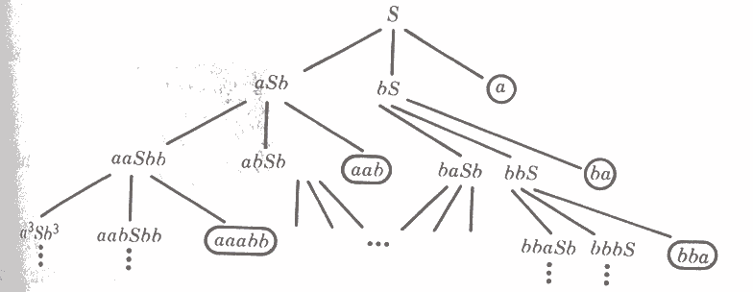
Total Language Tree
Yrd. Doç. Dr. R. Cenk Erdur, 2012

Slide 23
Total Language Tree
S → SAS | b
A → ba | b
is given.
Construct the total language tree.
Yrd. Doç. Dr. R. Cenk Erdur, 2012

Slide 24
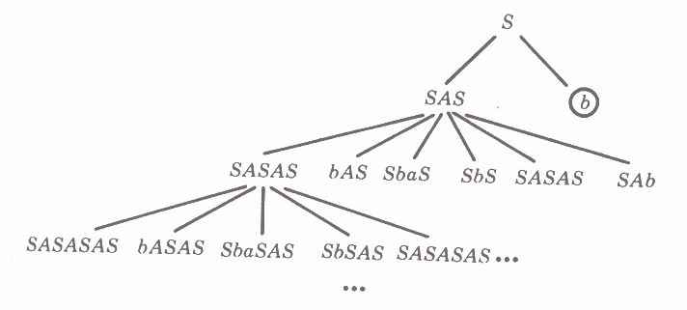
Total Language Tree
Yrd. Doç. Dr. R. Cenk Erdur, 2012

Slide 25
Push Down Automata (PDA)
The languages that are defined using a CFG are called Context Free Languages (CFL).
PDA is CFL acceptor. (Remember that finite automata models are regular language acceptors.)
PDA
FA, NFA, TG
Yrd. Doç. Dr. R. Cenk Erdur, 2012

Slide 26
PDA Basic Components -1
An alphabet of input symbols.
Input tape
  The concept of cell
A stack and a stack alphabet
Start state
Final states
  ACCEPT / REJECT
Stack push state
Yrd. Doç. Dr. R. Cenk Erdur, 2012

Slide 27
PDA Basic Components -2
Two kinds of branching:
  READ and POP
READ
POP
Yrd. Doç. Dr. R. Cenk Erdur, 2012

Slide 28
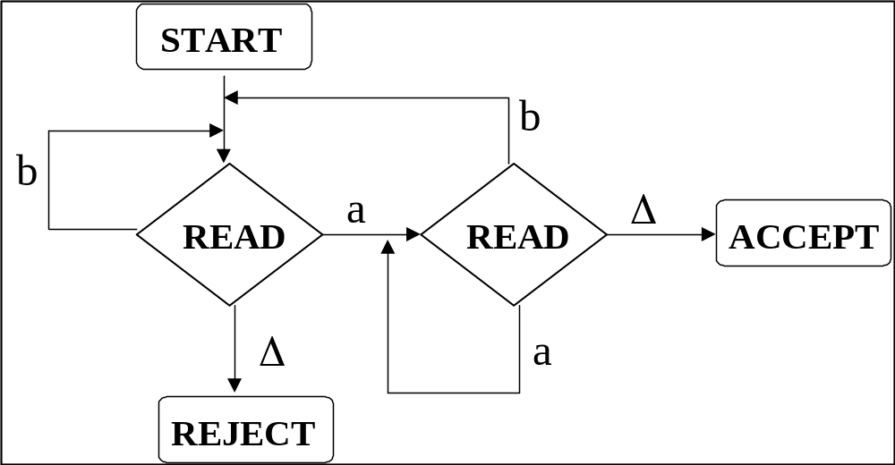
PDA for (a+b)*a
Yrd. Doç. Dr. R. Cenk Erdur, 2012

Slide 29
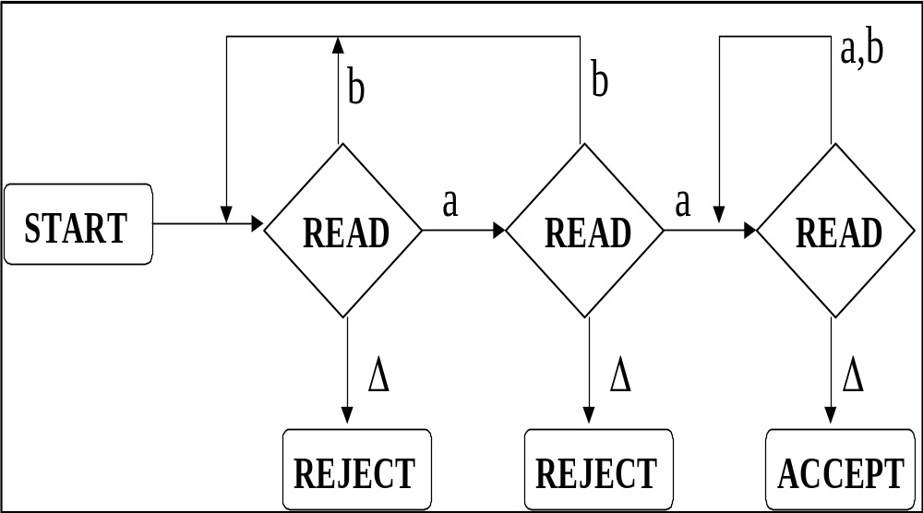
PDA for (a+b)*aa(a+b)*
Yrd. Doç. Dr. R. Cenk Erdur, 2012

Slide 30
PDA for a^{n}b^{n}
START
ACCEPT
Δ
a
READ
Δ
POP
PUSH
X
b
b
Δ
POP
X
READ
X
a
Δ
REJECT
Yrd. Doç. Dr. R. Cenk Erdur, 2012

Slide 31
PalindromeX
PalindromeX, is the language of all strings s such that sXreverse(s). s; can be any word from (a+b)* .
Construct a PDA for PalindromeX.
Yrd. Doç. Dr. R. Cenk Erdur, 2012

Slide 32
PDA for PalindromeX
START
READ
X
a
PUSH
a
b
PUSH
b
Yrd. Doç. Dr. R. Cenk Erdur, 2012

Slide 33
PDA for PalindromeX
X
ACCEPT
a
Δ
READ
Δ
POP
POP
a
b
POP
b
Yrd. Doç. Dr. R. Cenk Erdur, 2012

Slide 34
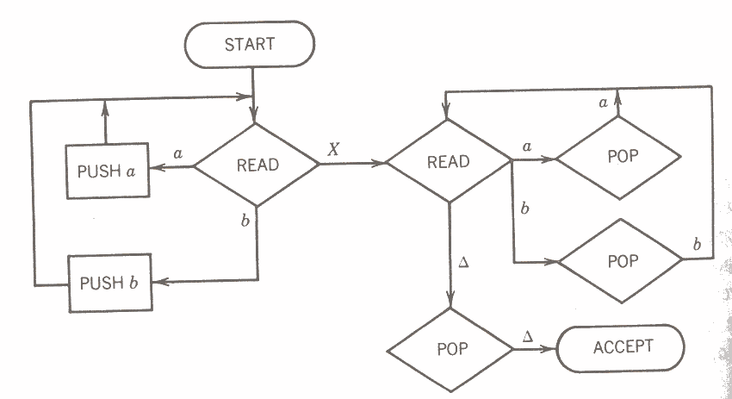
PalindromeX (Whole Machine)
Yrd. Doç. Dr. R. Cenk Erdur, 2012

Slide 35
Question
“OddPalindrome” is the language of palindrome words that contain an odd number of symbols. Alphabet={a,b}.
Construct a PDA model.
Yrd. Doç. Dr. R. Cenk Erdur, 2012

Slide 36
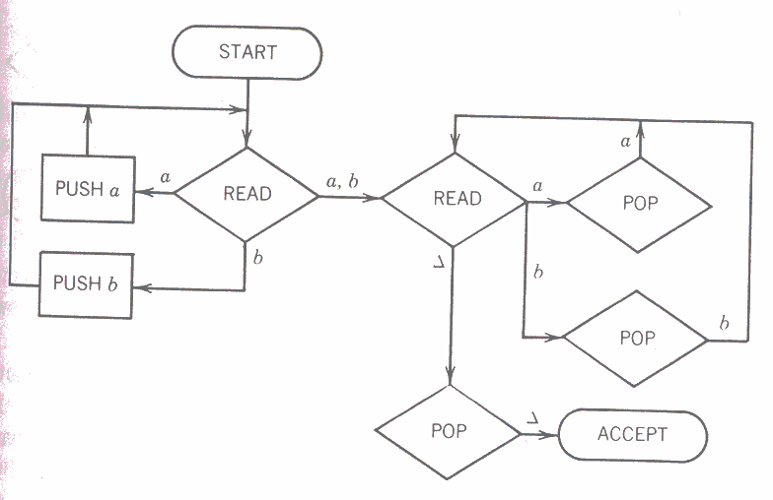
Odd Palindrome
Yrd. Doç. Dr. R. Cenk Erdur, 2012

Slide 37
Question
Construct a non-deterministic PDA model for EvenPalindrome language.
Yrd. Doç. Dr. R. Cenk Erdur, 2012

Slide 38
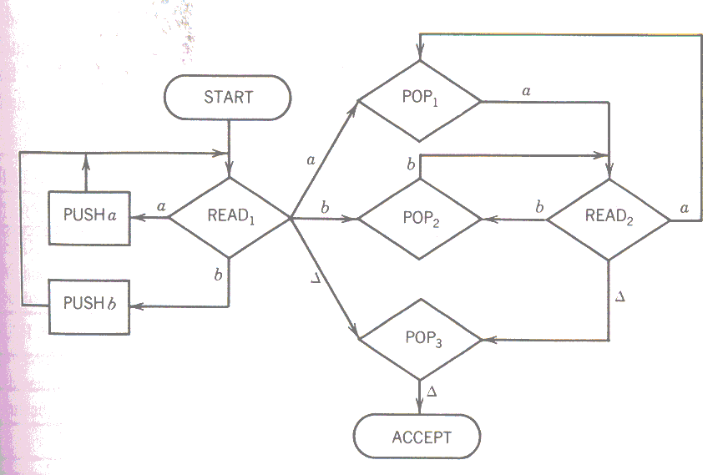
Even Palindrome
Yrd. Doç. Dr. R. Cenk Erdur, 2012

